Slide 1
Information Assignment 3

Slide 2
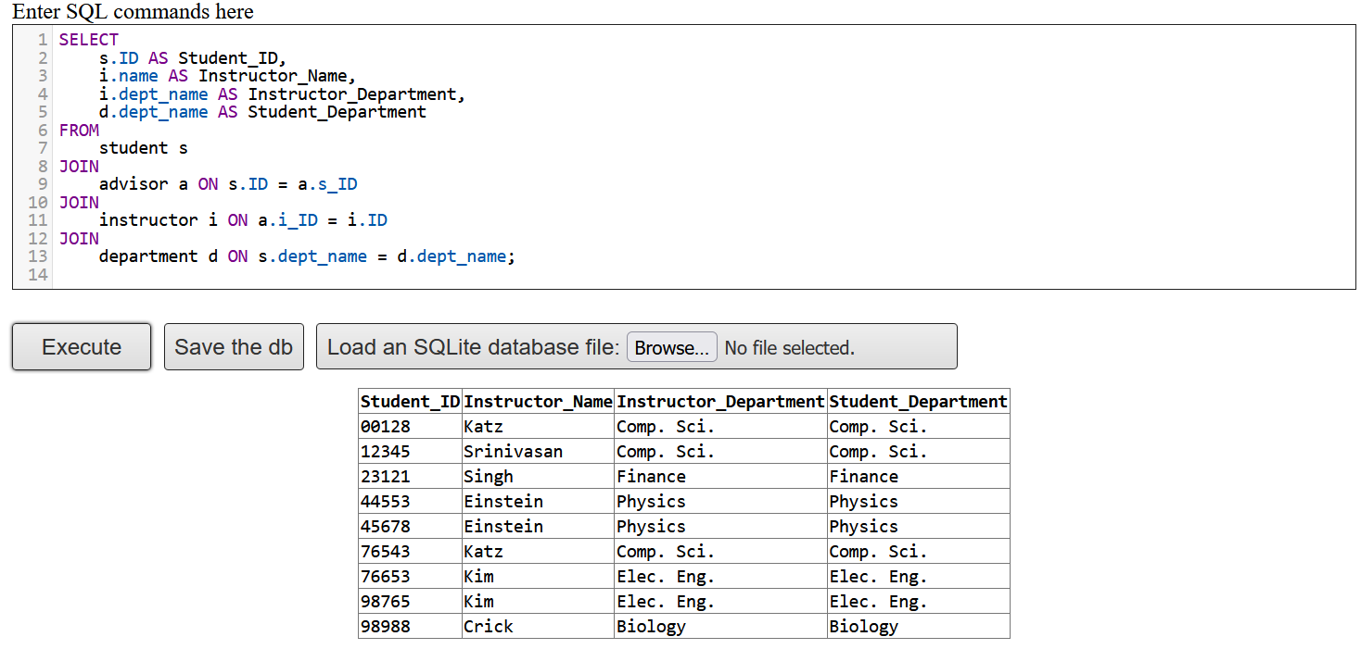
Question 2

Slide 3
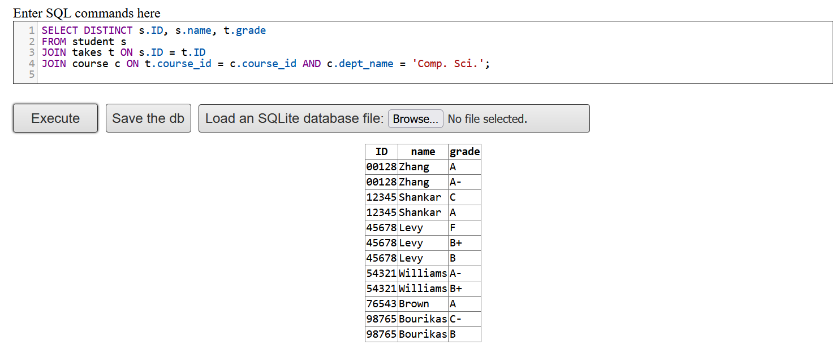
Question 3

Slide 4
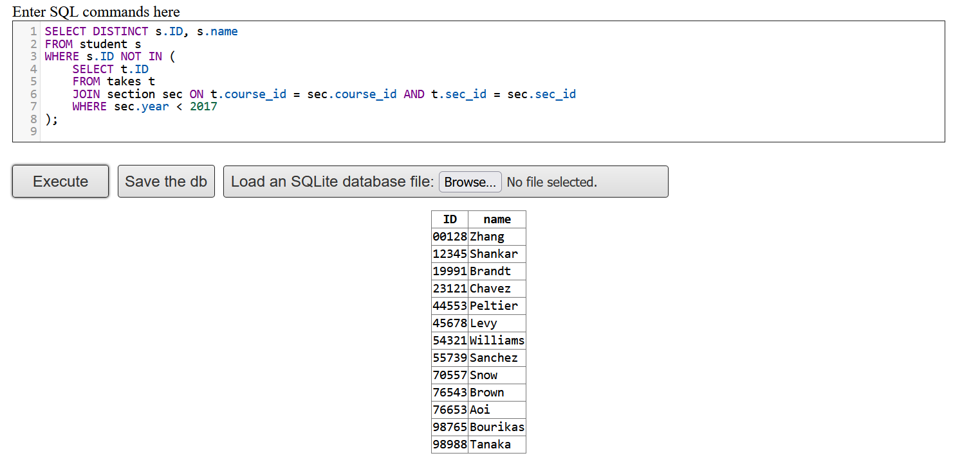

Slide 5


Slide 6


Slide 7
